Slide 1

VERBS:
A verb is a word used to Express an Action or a State.
Verbs are action words.
They tell us what action a noun or a pronoun is doing. E.g. work, dance, sing, etc.

Slide 2
Verb
Regular verb/Main verb.
Helping Verb.

Slide 3
Regular verb
V(1) – Present (Go)
V(2) – Past (went)
V(3) – Past Participle (gone)
V(4) – continuous (going)

Slide 4
Helping Verb : definition
A verb that comes before the main verb in a sentence. Together the helping verb and the main verb form a verb phrase.
To ‘BE’
To ’HAVE’
To ‘Do’
Notes:
To be :
Present tense: Is/Am/Are
Past tense: was/were
Future tense: will be
To have:
Present : have/has
Past : had
Future : will have
Verb :to Do
Present tense: Do/Does
Past tense: Did
Future tense: will do

Slide 5
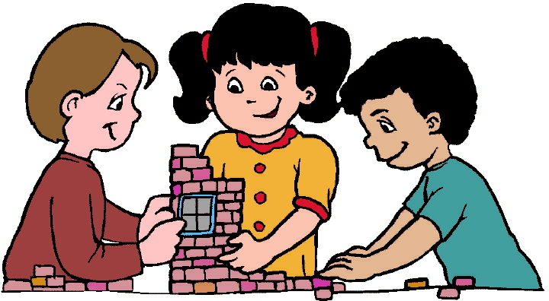
Activity
Notes:
Create pronoun chart and add the helping verbs in that…..take one form say to be – present – is/am/are and connect with the pronoun chart.
Create 9 charts by taking each form of helping verb.

Slide 6
Adverb
An Adverb is a verb, which modifies the meaning of a Verb, an adjective or another Adverb.
Example
Hari has just entered.
This is a very pretty dress.

Slide 7
How
She works sincerely.
He talks boastfully

Slide 8
Where
The accident took place there.
Reena lives here.

Slide 9
When
She just came.
Now, he has reached Delhi.

Slide 10
Often
He never tells a lie.
She is always dressed a white.

Slide 11
How much
The light travels very fast.
She was completely exhausted.

Slide 12
By adding ‘ly’ adjective
Wise – wisely
True – truly
Sincere – sincerely
Strong – strongly
Double- doubly
Busy – busily
Willing – willingly

